Slide 1

Integer Programming and Network Analysis
Term Project Introduction
2023 / 04 / 20

Slide 2
Term project
Presentation date: May 25th
Weight: 15% of the final grade
Please upload your:
output files (3 in total) and source code (deadline: May 22th 8:59)
presentation slide (deadline: May 24th 23:59)
Please use only CPLEX as the solver.
Designing more efficient algorithms is optional and will be viewed as bonus. Please upload the algorithm source code and output files too.

Slide 3
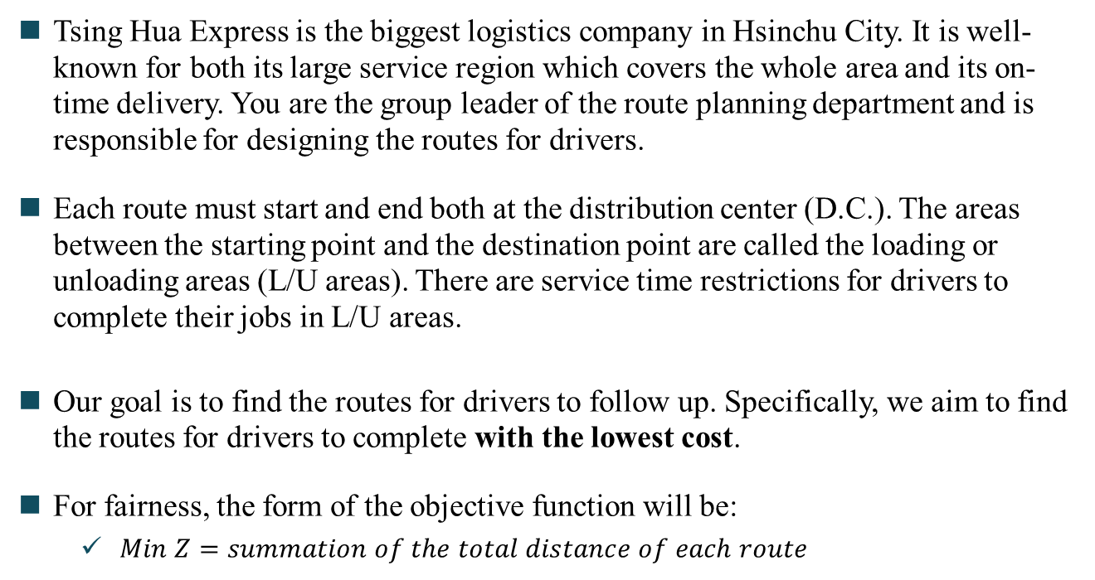
Problem Description
Tsing Hua Express is the biggest logistics company in Hsinchu City. It is well-known for both its large service region which covers the whole area and its on-time delivery. You are the group leader of the route planning department and is responsible for designing the routes for drivers.
Each route must start and end both at the distribution center (D.C.). The areas between the starting point and the destination point are called the loading or unloading areas (L/U areas). There are service time restrictions for drivers to complete their jobs in L/U areas.
Our goal is to find the routes for drivers to follow up. Specifically, we aim to find the routes for drivers to complete with the lowest cost.
For fairness, the form of the objective function will be:
$Min Z=summation of the total distance of each route$

Slide 4

Instances
You will have 3 vehicle information csv files, e.g.
vehicle_info_25.csv
vehicle_info_50.csv
vehicle_info_75.csv
“number” means the number of vehicles that your company has, and you should send them to complete the job.
The summation of the nodes’ demands that each vehicle travel cannot exceed the value of “capacity”.

Slide 5
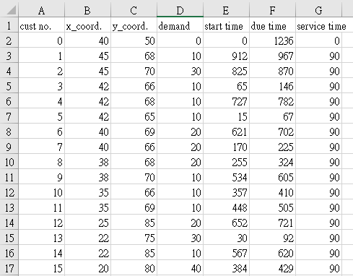
Instances
You will get 3 customer information csv files, e.g.
customer_info_25.csv
customer_info_50.csv
customer_info_75.csv
Note that the row 2 is the information of distribution center, and the other rows are the information of L/U areas.

Slide 6
Instances
“cust no.” is the number of node, which represent the D.C. and L/U areas.
Each node has its x_coord. and y_coord. which represent its location. Note that the distance is Euclidean, and the value of travel time is equal to the value of distance between 2 nodes.
Each area has its demand for vehicles to deliver. Note that your planning result cannot exceed the vehicle capacity.

Slide 7
Instances
In this example, every vehicle should come back before 1236. Also, Every node “must” be visited between start time and due time. (service time restriction)
Each area requires service time for drivers to complete their job.

Slide 8
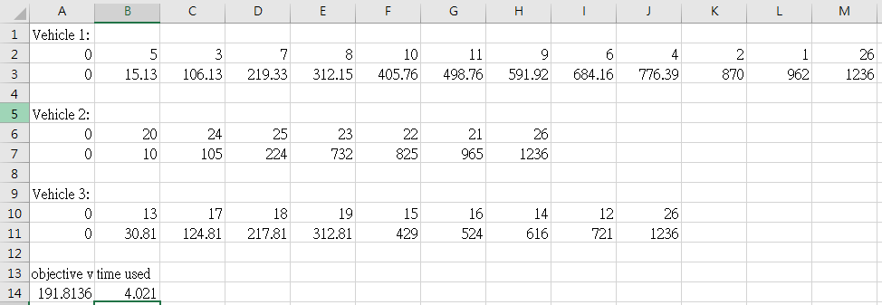
Output Files
Example: 25 L/U areas in the network.
node 0: D.C. (source), node 26: D.C. (sink)
Red rectangle: print out the nodes that the vehicle has traveled, and every node should be visited once by one of the vehicles.
Green rectangle: print out the arrival time of each node (round to 2 decimal places).

Slide 9
Output Files
The objective value of your model.(after calculating the total distance, round to 4 decimal places.)
The total computing time solved by CPLEX on your model (in seconds).
You should submit 3 output csv files, e.g.
Team0_output_25.csv
Team0_output_50.csv
Team0_output_75.csv

Slide 10
Grading
Based on your submissions:
presentation: 30% / 100%
solution quality: 70% / 100%
3 output files (the grade you get on solution quality):
bonus: efficient algorithm designed by your team (optional)
The limit of computing time is 30 minutes.
Your results will be ranked for grading.

Slide 11
Grading
About presentation (30%):
Content (model design, result analysis, PPT layout): 18% / 30%
Oral presentation (fluent in English): 9% / 30%
Time control (10 minutes presentation + 3 minutes Q&A): 3% / 30%
About solution quality (70%):
We will test 3 instances for your computing times and your objective values.
In total of 70%, each grade of the 3 instances:
75 L/U areas: 20% / 70%
50 L/U areas: 20% / 70%
25 L/U areas: 30% / 70%
Notes:
QA可以用中文

Slide 12
Grading
For 25 L/U areas’ instance (30%):
computing time | grade (10%)
less than 10 seconds | 10%
10 ~ 30 seconds | 8%
30 ~ 60 seconds | 7%
more than 60 seconds | 5%
Number of customers: 25
Objective value: 191.8136 (optimality)
Computing time: 4.021 seconds
We achieved the above solution by C#.
Your source code will be run at the following environment: Windows, Intel i7-8700, 3.20 GHz CPU and 8 GB of memory.
objective value | grade (20%)
reach optimality | 20%
top 25% if not optimal | 16%
26% - 50% if not optimal | 13%
51% - 100% if not optimal | 10%
Notes:
若 out of memory 的話，只會給10分

Slide 13
Grading
For 50 L/U areas’ instance (20%):
computing time | grade (10%)
less than 2.5 minutes | 10%
2.5 ~ 6 minutes | 8%
6 ~ 12 minutes | 7%
more than 12 minutes | 5%
Number of customers: 50
Objective value: 363.2468 (optimality)
Computing time: 118.865 seconds
We achieved the above solution by C#.
Your source code will be run at the following environment: Windows, Intel i7-8700, 3.20 GHz CPU and 8 GB of memory.
objective value | grade (10%)
reach optimality | 10%
top 25% if not optimal | 7%
26% - 50% if not optimal | 6%
51% - 100% if not optimal | 5%
Notes:
若 out of memory 的話，只會給5分

Slide 14
Grading
For 75 L/U areas’ instance (20%):
computing time | grade (10%)
less than 1 hour | 10%
1 ~ 1.5 hours | 8%
1.5 ~ 2 hours | 7%
more than 2 hours | 5%
Number of customers: 75
Objective value: 650.349 (optimality)
Computing time: 2,969.490 seconds
We achieved the above solution by C#.
Your source code will be run at the following environment: Windows, Intel i7-8700, 3.20 GHz CPU and 8 GB of memory.
objective value | grade (10%)
reach optimality | 10%
top 25% if not optimal | 7%
26% - 50% if not optimal | 6%
51% - 100% if not optimal | 5%
Notes:
若 out of memory 的話，只會給5分

Slide 15
Bonus
For 50 L/U areas’ instance (5%):
The limit of computing time is 30 minutes.
Your source code will be run at the following environment: Windows, Intel i7-8700, 3.20 GHz CPU and 8 GB of memory.
objective value | grade (5%)
top 20% | 5%
21% - 40% | 4%
41% - 60% | 3%
61% - 80% | 2%
80% - 100% | 1%
You should submit 1 output csv files, e.g.
Team0_bonus_output_50.csv

Slide 16
Bonus
For 75 L/U areas’ instance (5%):
The limit of computing time is 30 minutes.
Your source code will be run at the following environment: Windows, Intel i7-8700, 3.20 GHz CPU and 8 GB of memory.
objective value | grade (5%)
top 20% | 5%
21% - 40% | 4%
41% - 60% | 3%
61% - 80% | 2%
80% - 100% | 1%
You should submit 1 output csv files, e.g.
Team0_bonus_output_75.csv

Slide 17
TA’s office hours
If you have any problem concerning about the term project, feel free to discuss with TAs.
Email one of us in advance.
黃信鈞：pop32154@kimo.com
陳明揚：mingyang.chen196@gmail.com
Office hours:
Wednesday 13:20-15:00 in Engineering Building I Room 703
Tuesday 14:20-16:00 in Engineering Building I Room 912
If you cannot show up at the previously mentioned time, you can email us to arrange a discussion for other time as well.

Slide 18

QR code

Slide 19
Thanks for listening ! Any questions ?

